Slide 1

Biomedical and Health Informatics Project: Searching for Pathology with Metabolomics using Machine Learning with Bayesian Networks
Author: Vincent Preikstas
Advisor: Dr. Isabelle Bichindaritz
6/22/2021

Slide 2
About Me
Studied computer science at SUNY Oswego as an undergraduate
Part of the HCI graduate program at SUNY Oswego

Slide 3
Abstract
Studying Cadmium, Lead and Mercury
Dataset from Syracuse with 299 child subjects with rich health data
Working off previous statistical analysis done by a prior graduate student
Used Bayesian Belief Networks to show connections between metals, metabolites, health measures and confounding factors
One network was learned from the data for each metal using Bayesian Search Algorithm

Slide 4
Introduction
Heavy metal toxicity is a widely studied topic
Lead, Mercury and Cadmium presence in blood known to negatively impact health
Linking different diseases to heavy metals is one thing, finding more nuanced interplay between the metals, other factors and disease is worth looking into

Slide 5
Background info and Significance
Robert Birdsall study covering effects of lead and mercury on the blood proteome of children (2010)
Posts on Web MD showing the increased risk with lead exposure for post menopausal women
Several other papers (please see works cited section for the full list)

Slide 6
Project Aims
Two main objectives
One: Summarize Jessica’s findings
Two: Use machine learning with Bayesian Networks to find interesting relationships between metabolites, confounding factors, health measures and metabolites

Slide 7
Project Methods (First Goal)
Jessica’s report and final document analysisResultsFinalV5(1).docx was downloaded from a google drive called Metabolomic which contained various files pertaining to the dataset
The document was reviewed and all significant findings were reported in this capstone project’s final report

Slide 8
Project Methods (Second Goal) Part 1
Cleaned and normalized the data using Excel was used along with Genie software
Jessica’s work was used to guide creation of learning data sets
Academic version of Genie tool was used from BayesFusion LLC and significant time was invested learning the software

Slide 9
Project Methods (Second Goal) Part 2
Normalization of data involved deletion, insertion and binning
Data needed to be discretized for the algorithm
Genie has several powerful features for data preprocessing and discretization

Slide 10
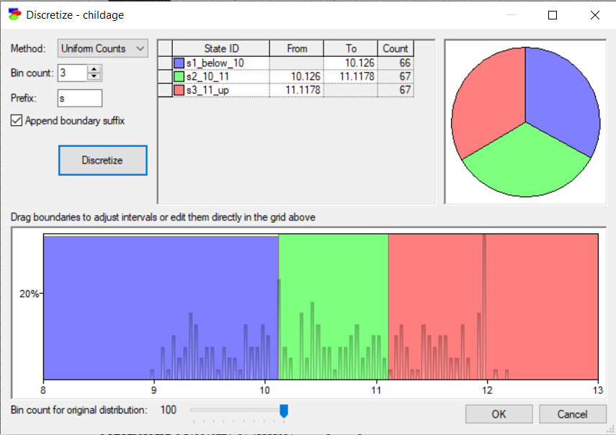
Example GUI for Discretizing Data in Genie

Slide 11
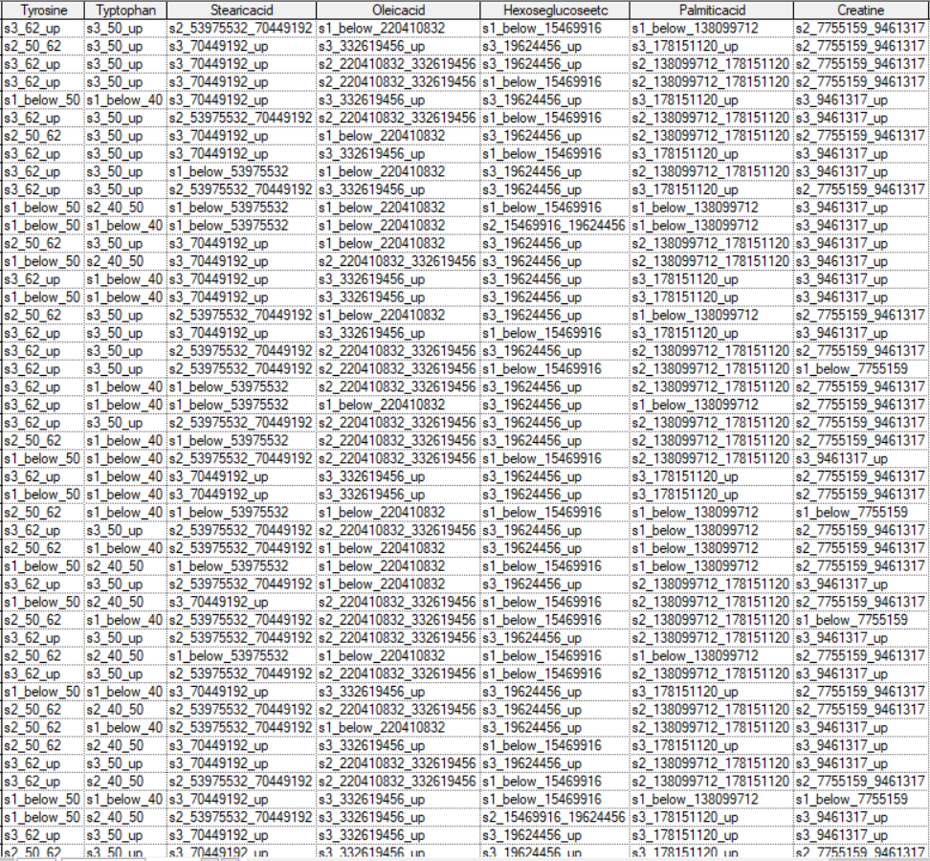
Example Cleaned Data Column in Excell

Slide 12
Project Methods (Second Goal) Part 3
Bayesian Search algorithm was used to do learning with default parameters in Genie
Temporal Tier were created to mimic prior knowledge and enforce directionality

Slide 13
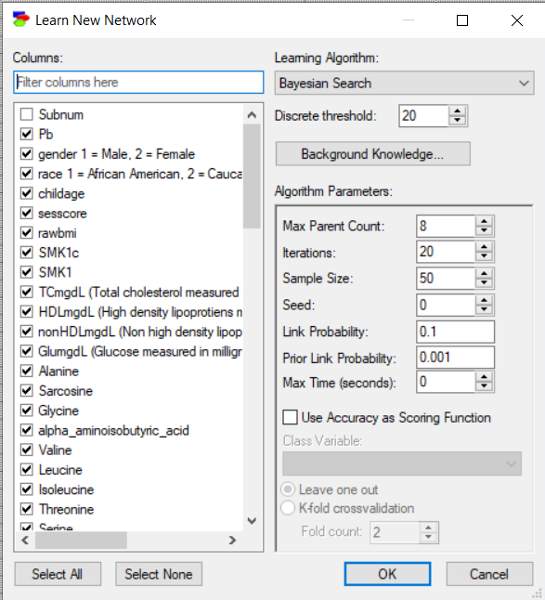
Bayesian Search Settings Used

Slide 14
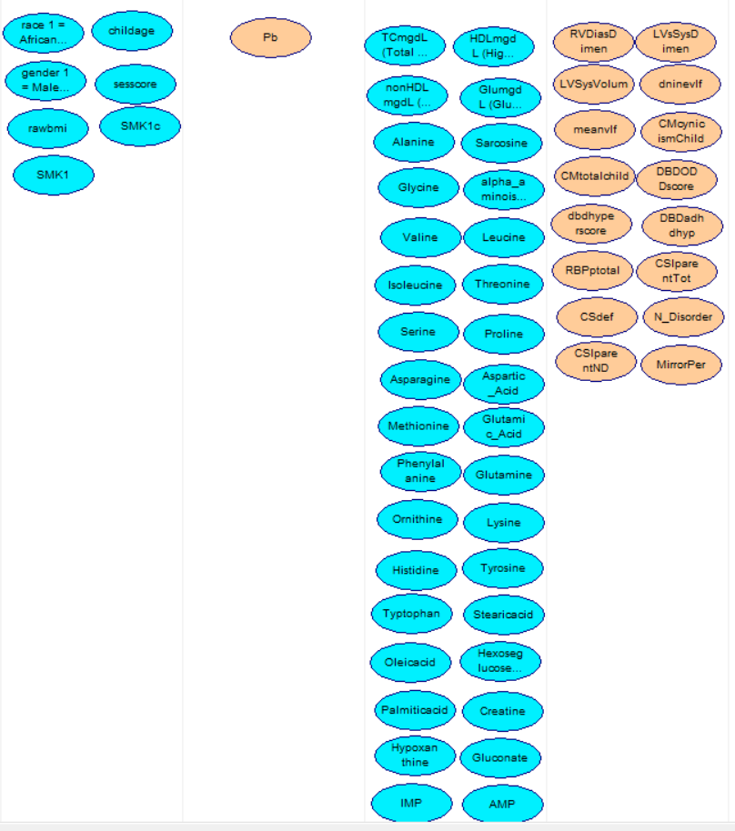
Temporal Tiers Created (Approximately the same for each Metal set)

Slide 15
Results
The lists created of correlated variables from Jessica’s work can be found in the project report
Three networks were created, one each for cadmium, lead and mercury

Slide 16
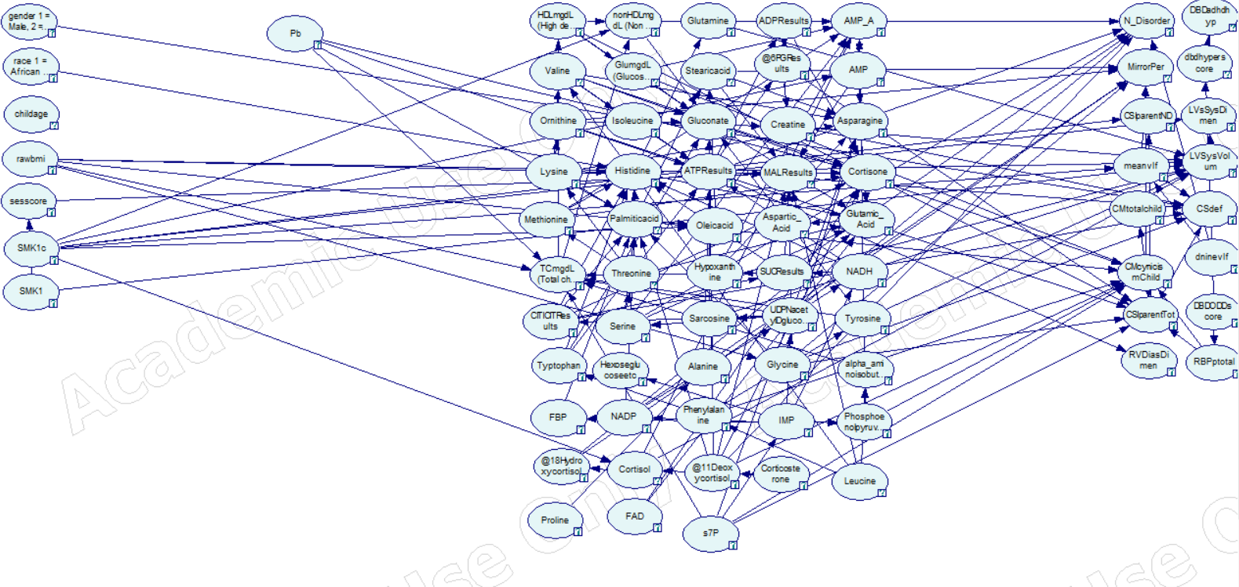
Lead Network

Slide 17
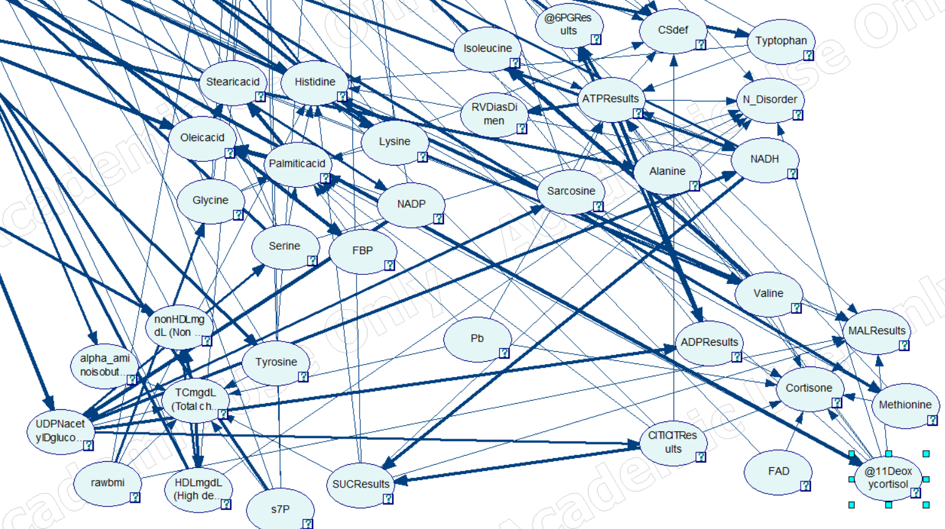
Lead Network Local Cluster

Slide 18
Lead Network Results
Lead had direct connections with four different metabolites: TCmgdl, Palmiticacid, ATPResults and Cortisone
Of Interest: ATP Results predictive of N_Disorder, Csdef and RVDiasDimen. @11Deoxycortisol predicts cortisone as well as N_Disorder. Rawbmi predicts TCmgdltotal

Slide 19
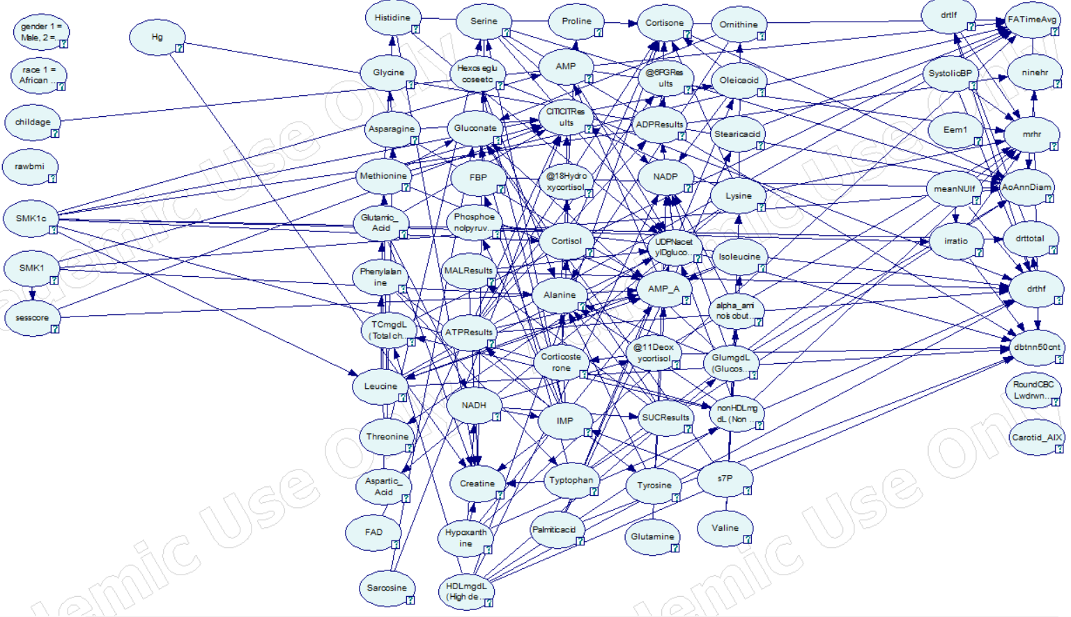
Mercury Network

Slide 20
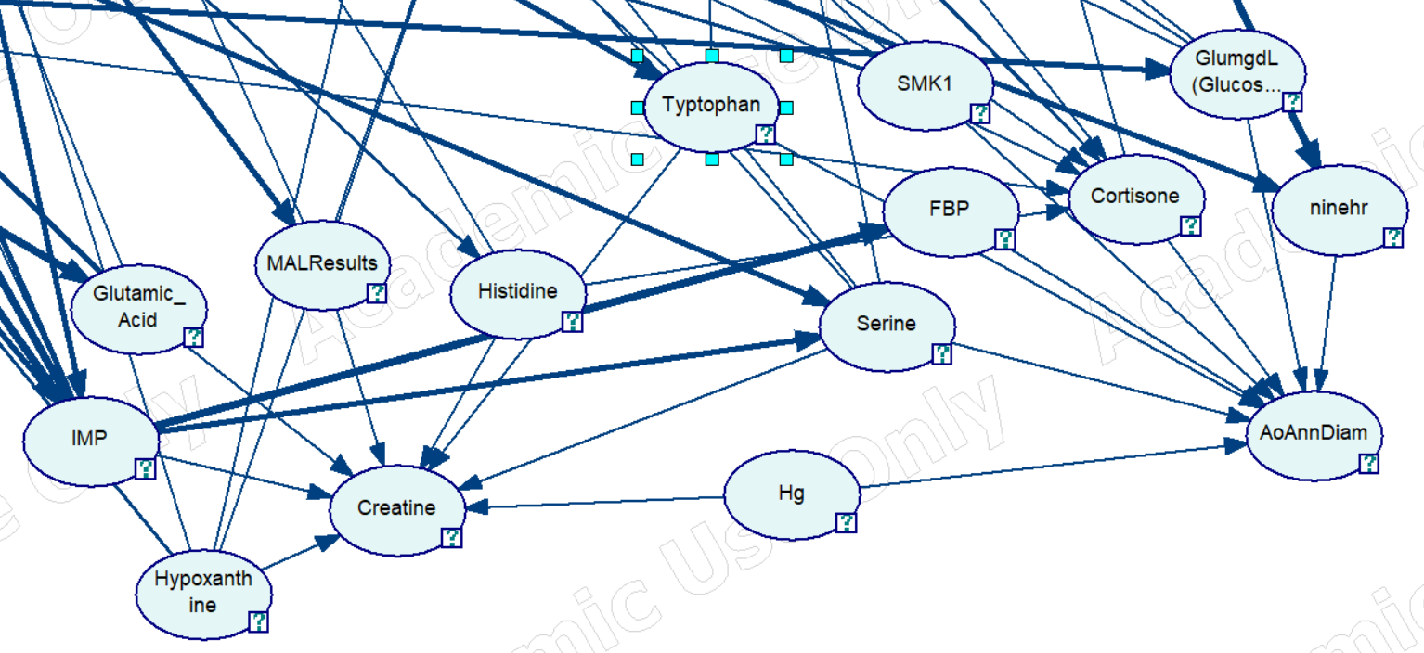
Mercury Network Local Cluster

Slide 21
Mercury Network Results
Mercury linked to metabolite Creatine and health measure AoAnnDiam
Of Interest: Mercury predicting AoAnnDiam and several metabolites also predicting AoAnnDiam. SMK1 predicting AoAnnDiam. Mercury predictive of Creatine with several other metabolites also predictive of Creatine

Slide 22
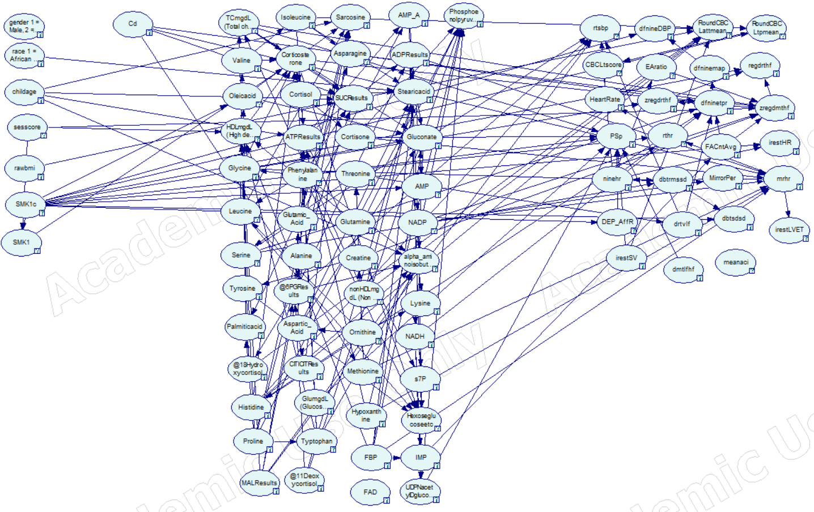
Cadmium Network

Slide 23
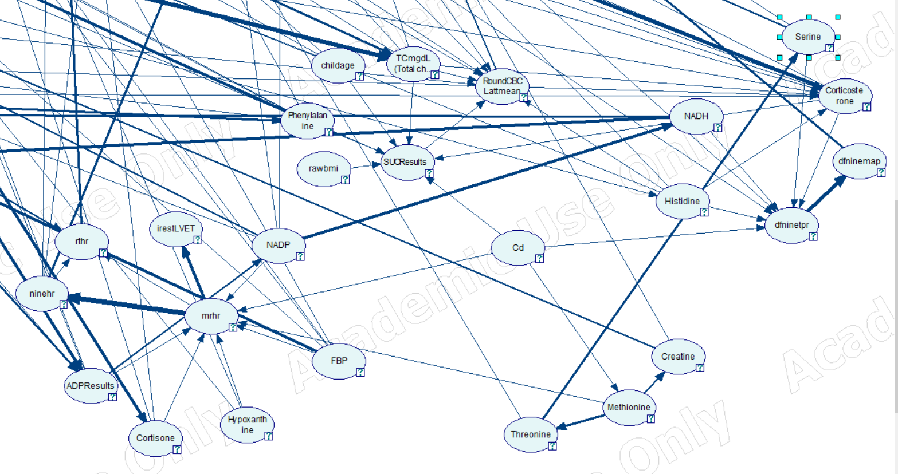
Cadmium Network Local Cluster

Slide 24
Cadmium Network Results
Cadmium predictive of metabolites Methionine and SUCResults and health measures mrhr and dfninetpre
Of Interest: Cadmium predicts both mrhr and Methionine while Methionine predicts mrhr. Cadmium predicts dfninetpr which predicts dfninemap

Slide 25
Discussion
Only a few examples of interesting connections were given so far, many more warrant interest in the networks shown
Any connection showing a chain between health measures, metals and metabolites could be indicative of an interesting relationship
Further refinement of prior knowledge could also yield different or interesting networks

Slide 26
Closing Thoughts
Several connections were identified using the Bayesian Network that warrant further inquiry
Using different data preprocessing may help yield other interesting results
Refining the data and dataset for future Bayesian Network creation could bear fruit

Slide 27
Thanks for Listening!
If you have any question about the project please feel free to email me at vpreikst@oswego.edu

Slide 28
Works Cited
Birdsall, R., Kiley, M., Segu, Z., Palmer, C., Madera, M., Gump, B., MacKenzie, J., Parsons, P., Mechref, Y., Novotny, M., Bendinskas, K. (2010). Effects of lead and Mercury on the Blood Proteome of Children. Journal of Proteome Research, 4443-4453.
Lead Levels Linked to Blood Pressure. (2003, March 25). Retrieved from https://www.webmd.com/hypertension-high-blood-pressure/news/20030325/lead-levels-linked-to-blood-pressure#
Chirinos, J., Akers, S., Trieu, L., Ischiropoulos, H. (2016). Heart Failure, Left Ventricular Remodeling, and Circulating Nitric Oxide Metabolites. Journal of the American Heart Association, 5(10). doi:https://doi/10.1161/JAHA.116.004133
Brownlee, J. (2019, October 11). A gentle introduction to bayesian belief networks. Retrieved February 07, 2021, from https://machinelearningmastery.com/introduction-to-bayesian-belief-networks/
Kraisangka, Jidapa & Druzdzel, Marek. (2014). Discrete Bayesian Network Interpretation of the Cox's Proportional Hazard Model. LNCS. 8754. 10.1007/978-3-319-11433-0_16.

